Slide 1
From ImageNet to Image Classification:
Contextualizing Progress on Benchmarks Dimitris Tsipras | Shibani Santurkar | Logan Engstrom | Andrew Ilyas | Aleksander Ma˛dry
Review presented by Mounica Subramani

Slide 2
Overview
Problem Statement
Original Work
ImageNet Dataset
ImageNet creation pipeline
Revisiting ImageNet Labels
Proposed Work
Framework – From Label Validation to Image Classification
Obtaining Candidate Labels
Image Classification via CLASSIFY task
Quantifying benchmark-task alignment of ImageNet
Multi-object images
Bias in label validation
Model Evaluation

Slide 3
Problem Statement
This paper takes a step towards understanding how closely the widely-used vision benchmarks align with real-world tasks, that they are meant to approximate.
Building rich Machine Learning datasets in a scalable manner often necessitates a crowd-sourced data collection pipeline.
This paper analysis pinpoints, how a noisy data collection pipeline can lead to a systematic misalignment between the resulting benchmark and the real-world task it serves as a proxy for.

Slide 4
Original Work
Data created through scalable methods, like building a dataset with the help of large group of people (Annotators)
Annotators were not asked to classify images, but rather to validate a specific automatically-obtained candidate label without knowledge of other classes in the dataset.
Leads to systemic annotation issues in the dataset, multi-object image problem and bias in the label validation
These issues results in tension between building realistic large-scale benchmarks and the scalable data collection pipeline

Slide 5
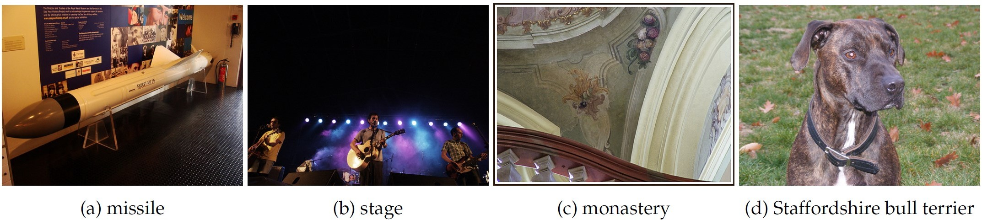
Correct Labels?
ImageNet Labels
projectile
acoustic guitar
church
American Staffordshire terrier

Slide 6
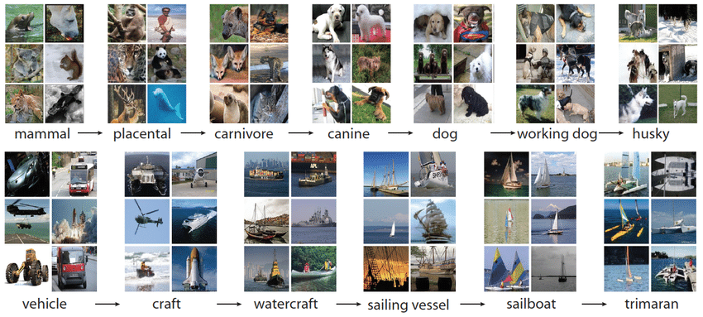
ImageNet Dataset
ImageNet is a prototypical example of large-scale dataset
It has 1000 classes and more than million images
Created through automated data collection and crowd-sourced filtering
Creation Pipeline has two stages
Image and Label collection
Image validation via CONTAINS task

Slide 7
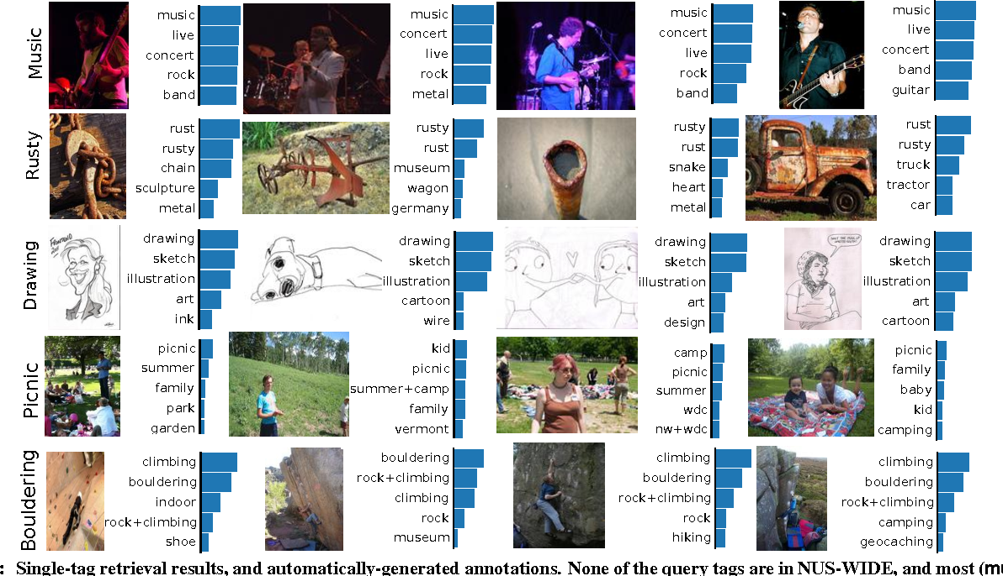
Image and label collection
Selected a set of classes using WordNet hierarchy
For each class, sourced images by querying several search engines
To expand image pool, performed queries in several languages
Label for image is given by the WordNet node that was used for query search

Slide 8
Image Validation – CONTAINS task
Employed annotators via the Mechanical Turk (MTurk) crowd-sourcing platform.
Annotators were presented with its class description and a grid of candidate images.
Select all images in the grid that contained an object of that class.
Only the images that received a “convincing majority” of votes were included in the ImageNet.
Annotators were presented with its class description (along with links to the relevant Wikipedia pages) and a grid of candidate images.

Slide 9
Revisiting the ImageNet Labels
Resulting data set might not accurately capture the ground truth.
The above discussed pipeline design itself can lead to systematic errors in dataset
The root cause for many of these errors is that the image validation stage (i.e., the CONTAINS task) asks annotators only to verify if a specific proposed label is valid for a given image.
Crucially, annotators are never asked to choose among different possible labels for the image and, in fact, have no knowledge of what the other classes even are.

Slide 10
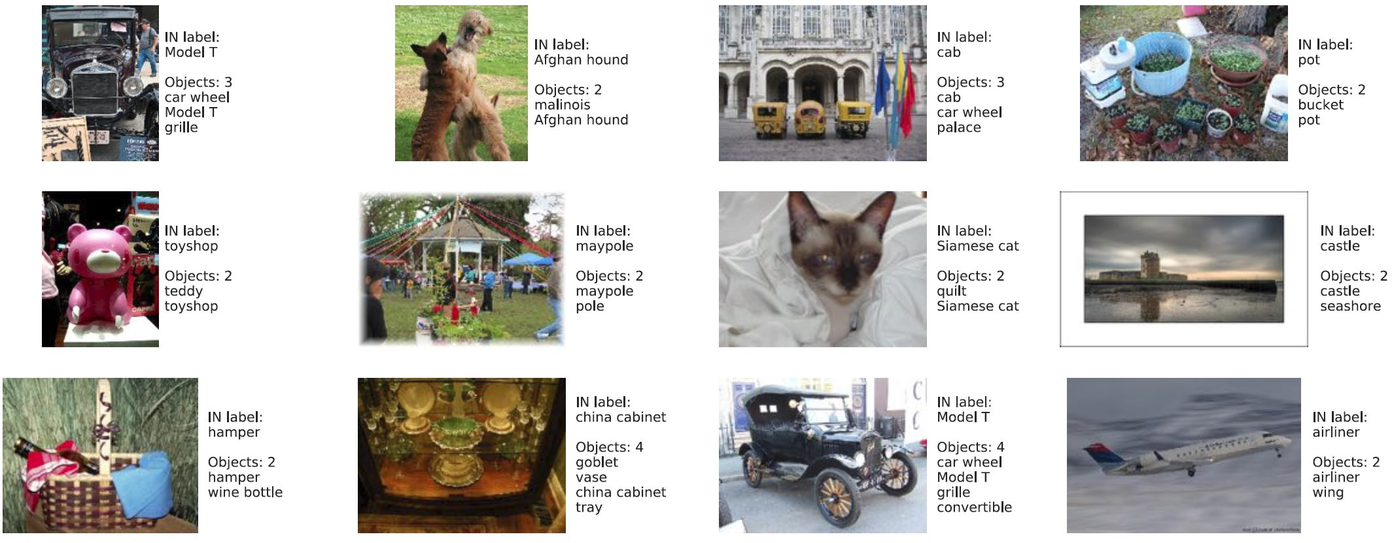
Images with Multiple Objects
Annotators are instructed to ignore the presence of other objects when validating a particular ImageNet label for an image.

Slide 11
Biases in I mage Filtering
Annotators (non-experts) have no knowledge of what the other classes are, they do not have a sense of the granularity of image features they should pay attention to.
Implies that potential errors in the collection process are unlikely to be corrected by during validation
Thus propagate to the final dataset

Slide 12
Proposed Work
Develop methodology for obtaining fine-grained data annotations via large-scale human studies
Address short fall of object recognition benchmarks
Current standard model evaluation is insufficient
Introducing Human-based performance evaluation

Slide 13
Framework Label Validation to Image Classification
Authors would like annotators to classify the image, selecting all the relevant labels for it.
There are two phases in this step.
First, they obtain a small set of (potentially) relevant candidate labels for each image.
Second, they present these labels to annotators and ask them to select one of them for each distinct object using what they call the CLASSIFY task.

Slide 14
Obtaining Candidate Labels
Obtain potential labels for each image by combining the top-5 predictions of 10 models from different parts of the accuracy spectrum with the existing ImageNet label.
Reuse the ImageNet CONTAINS task—asking annotators whether an image contains a particular class but for all potential labels
Outcome of this experiment is Selection Frequency for each image-label pair
Restricting potential labels to this smaller set of candidate labels

Slide 15
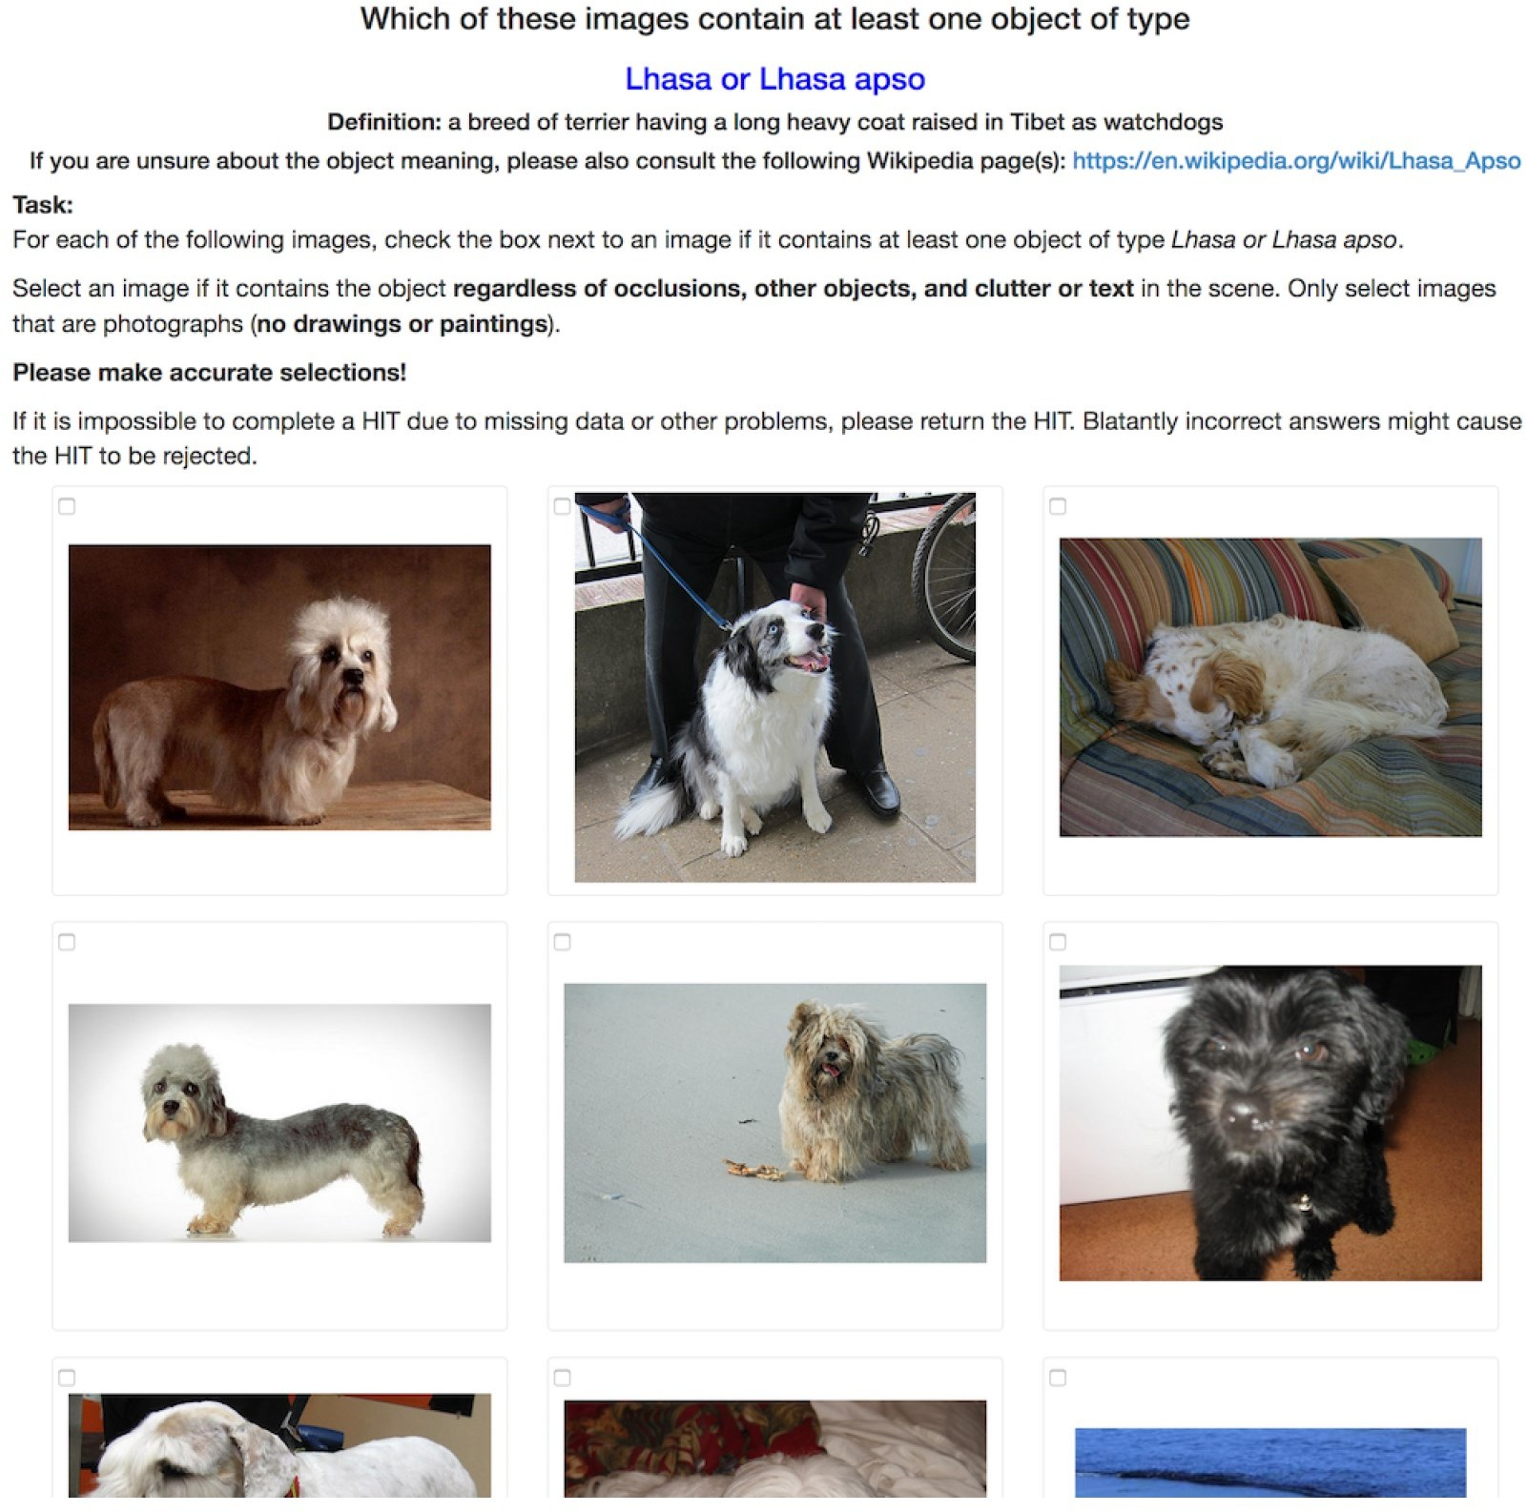
Obtaining Candidate Labels

Slide 16
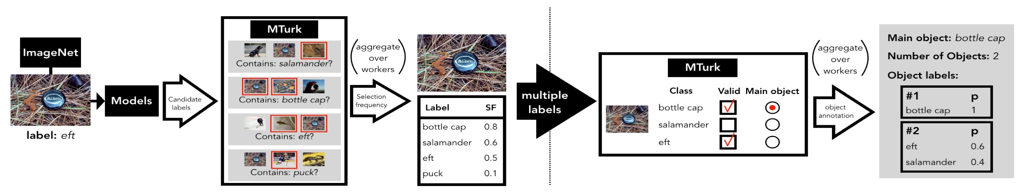
Image Classification via the CLASSIFY Task
Asking annotators to identify
All labels that correspond to objects in the image.
The label for the main object (according to their judgment).
Select only one label per distinct object except mutually exclusive objects.
Identifying the main label and number of objects
From each annotator’s response, authors learn what they consider to be the label of the main object, as well as how many objects they think are present in the image

Slide 17
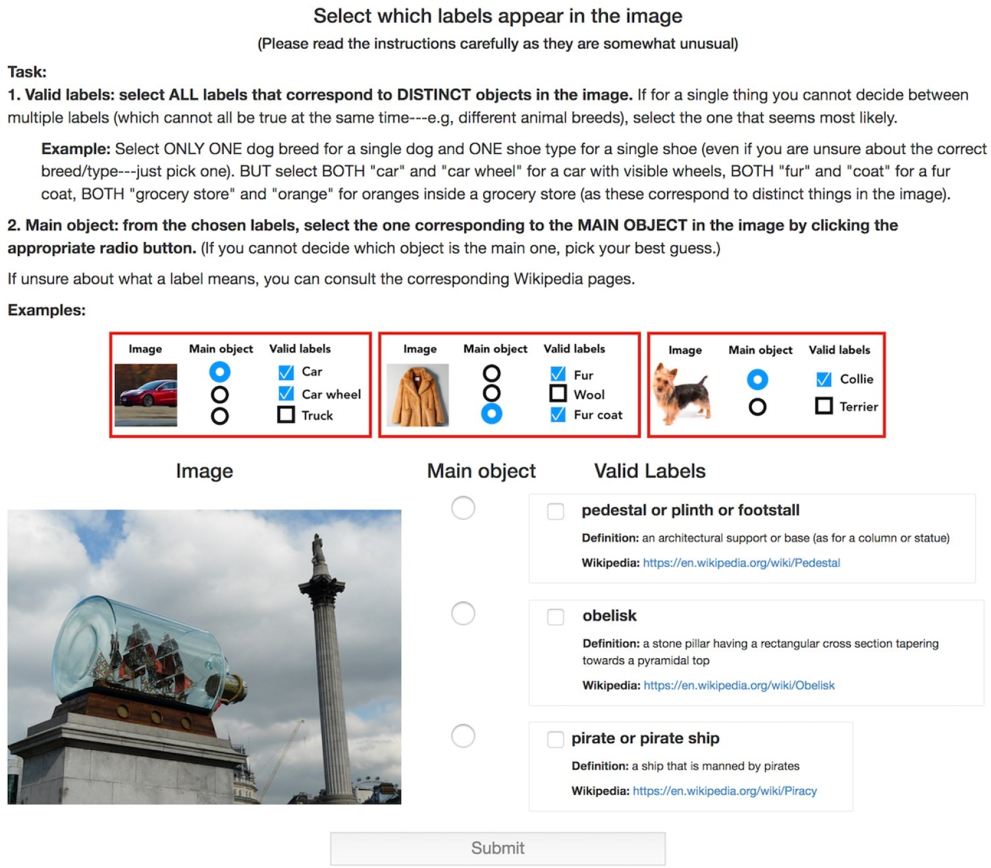
Image Classification via the CLASSIFY Task

Slide 18
Quantifying the Benchmark-Task Alignment of ImageNet
Multi-object images
More than 1/5 of the ImageNet dataset contains at least two objects.
Models perform significantly worse on multi-label images based on top-1 accuracy (measured w.r.t. ImageNet labels): accuracy drops by more than 10% across all models.
There are pairs of classes which consistently co-occur.
Model accuracy is especially low on certain classes that systematically co- occur.
A more natural notion of accuracy for multi-object images would be, to consider a model prediction to be correct if it matches the label of any object in the image.

Slide 19
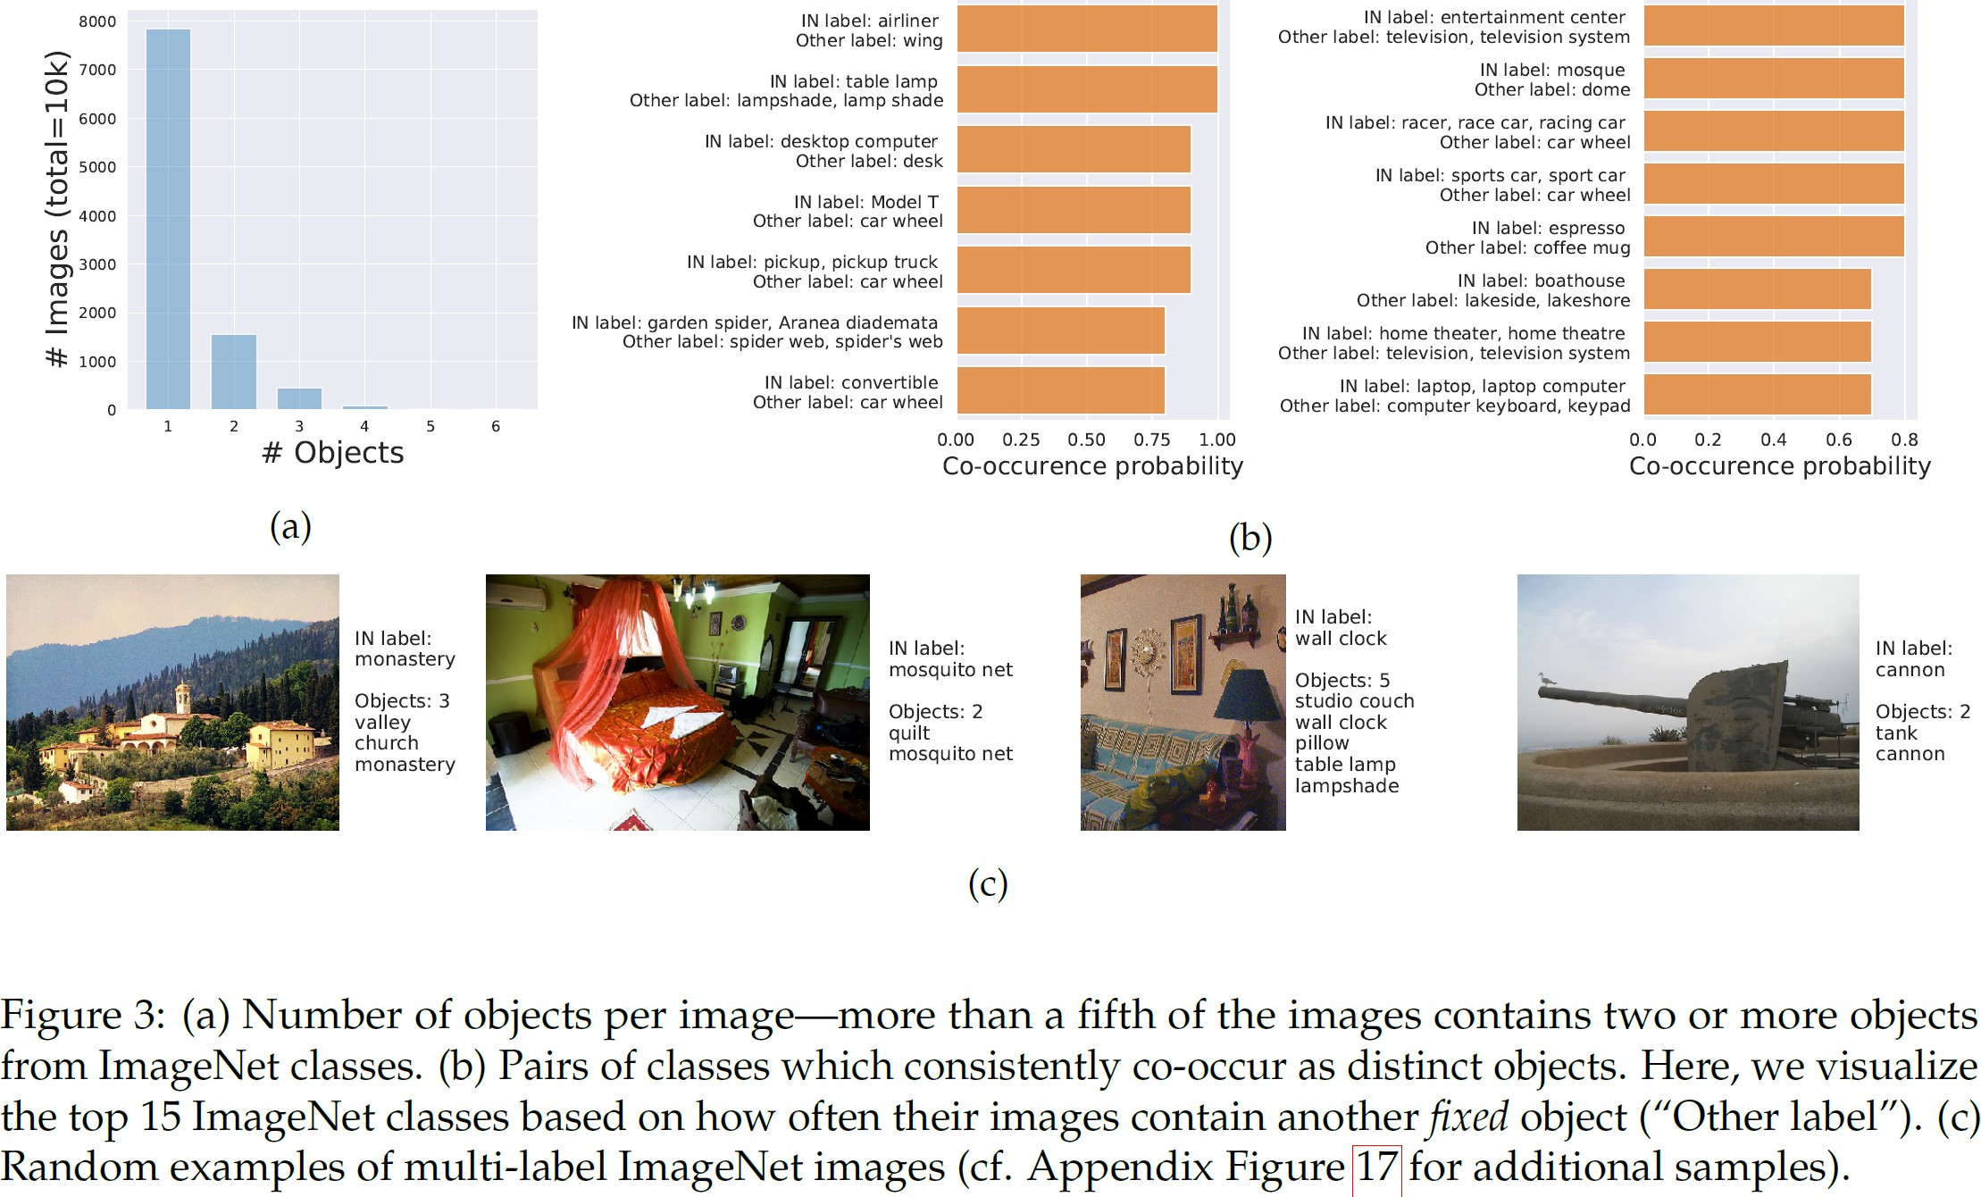
Multi-Object Images

Slide 20
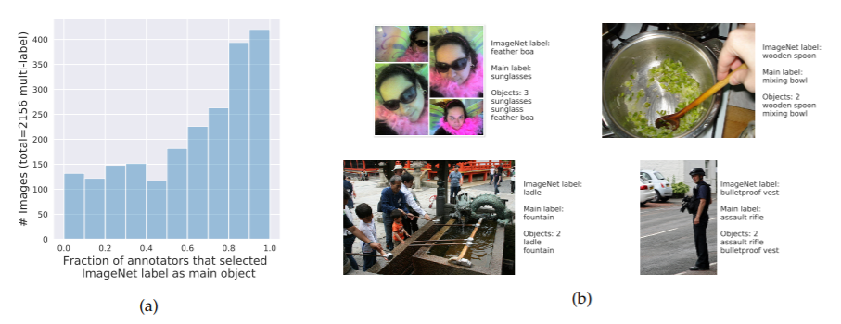
Multi-Object Images: Human-label disagreement
Although models suffer a sizeable accuracy drop on multi-object images, they are still relatively good at predicting the ImageNet label.
This bias could be justified whenever there is a distinct main object in the image and it corresponds to the ImageNet label.
For nearly a third of the multi-object images, the ImageNet label does not denote the most likely main object as judged by human annotators.

Slide 21
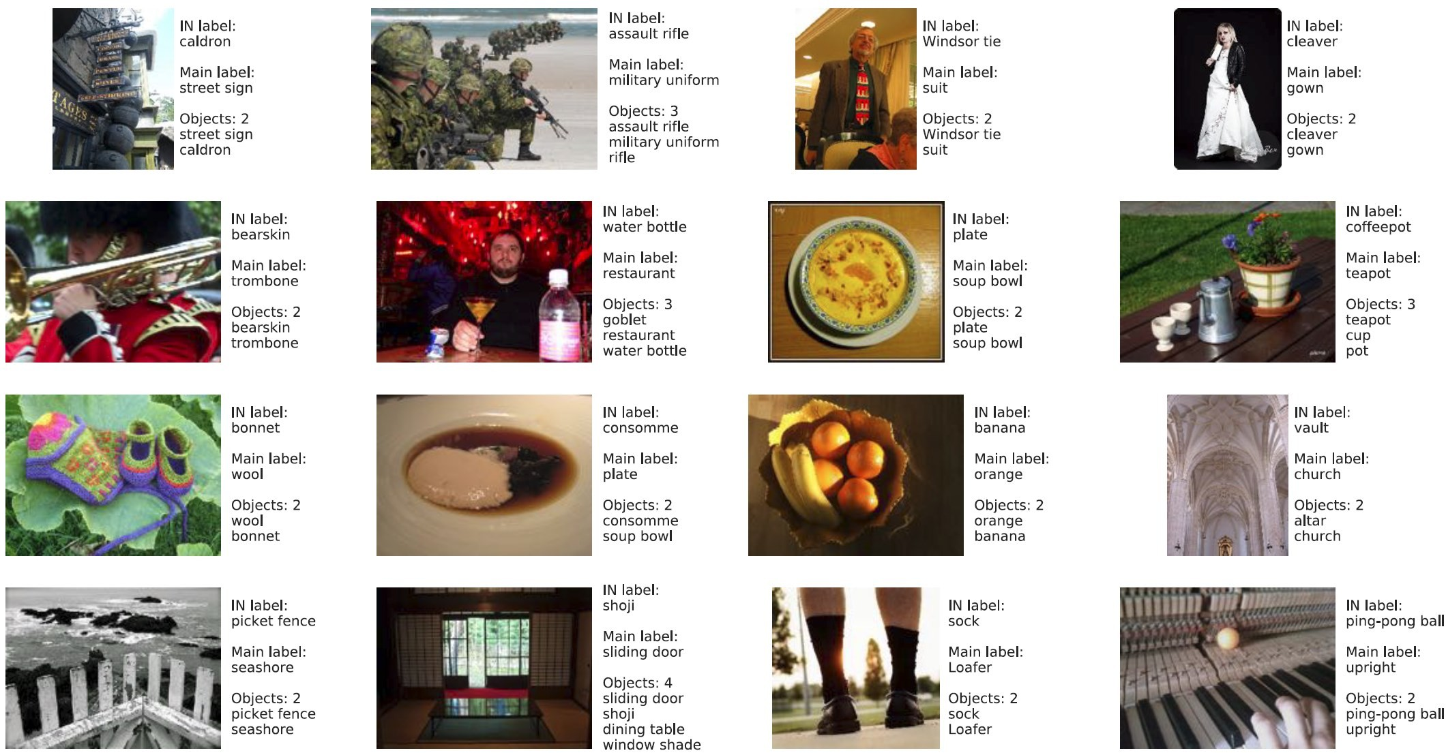
Human-Label disagreement

Slide 22
Quantifying the Benchmark-Task Alignment of ImageNet
Bias in label validation
Recall that annotators are asked a somewhat leading question, of whether a specific label is present in the image, making them prone to answering positively even for images of a different, yet similar, class.
Under the original task setup (i.e., the CONTAINS task), annotators consistently select multiple labels, for nearly 40% of the images, another label is selected at least as often as the ImageNet label.
Even when annotators perceive a single object, they often select as many as 10 classes.
If instead of asking annotators to judge the validity of a specific label(s) in isolation, asking them to choose the main object among several possible labels simultaneously (i.e., via the CLASSIFY task), they select substantially fewer labels.

Slide 23
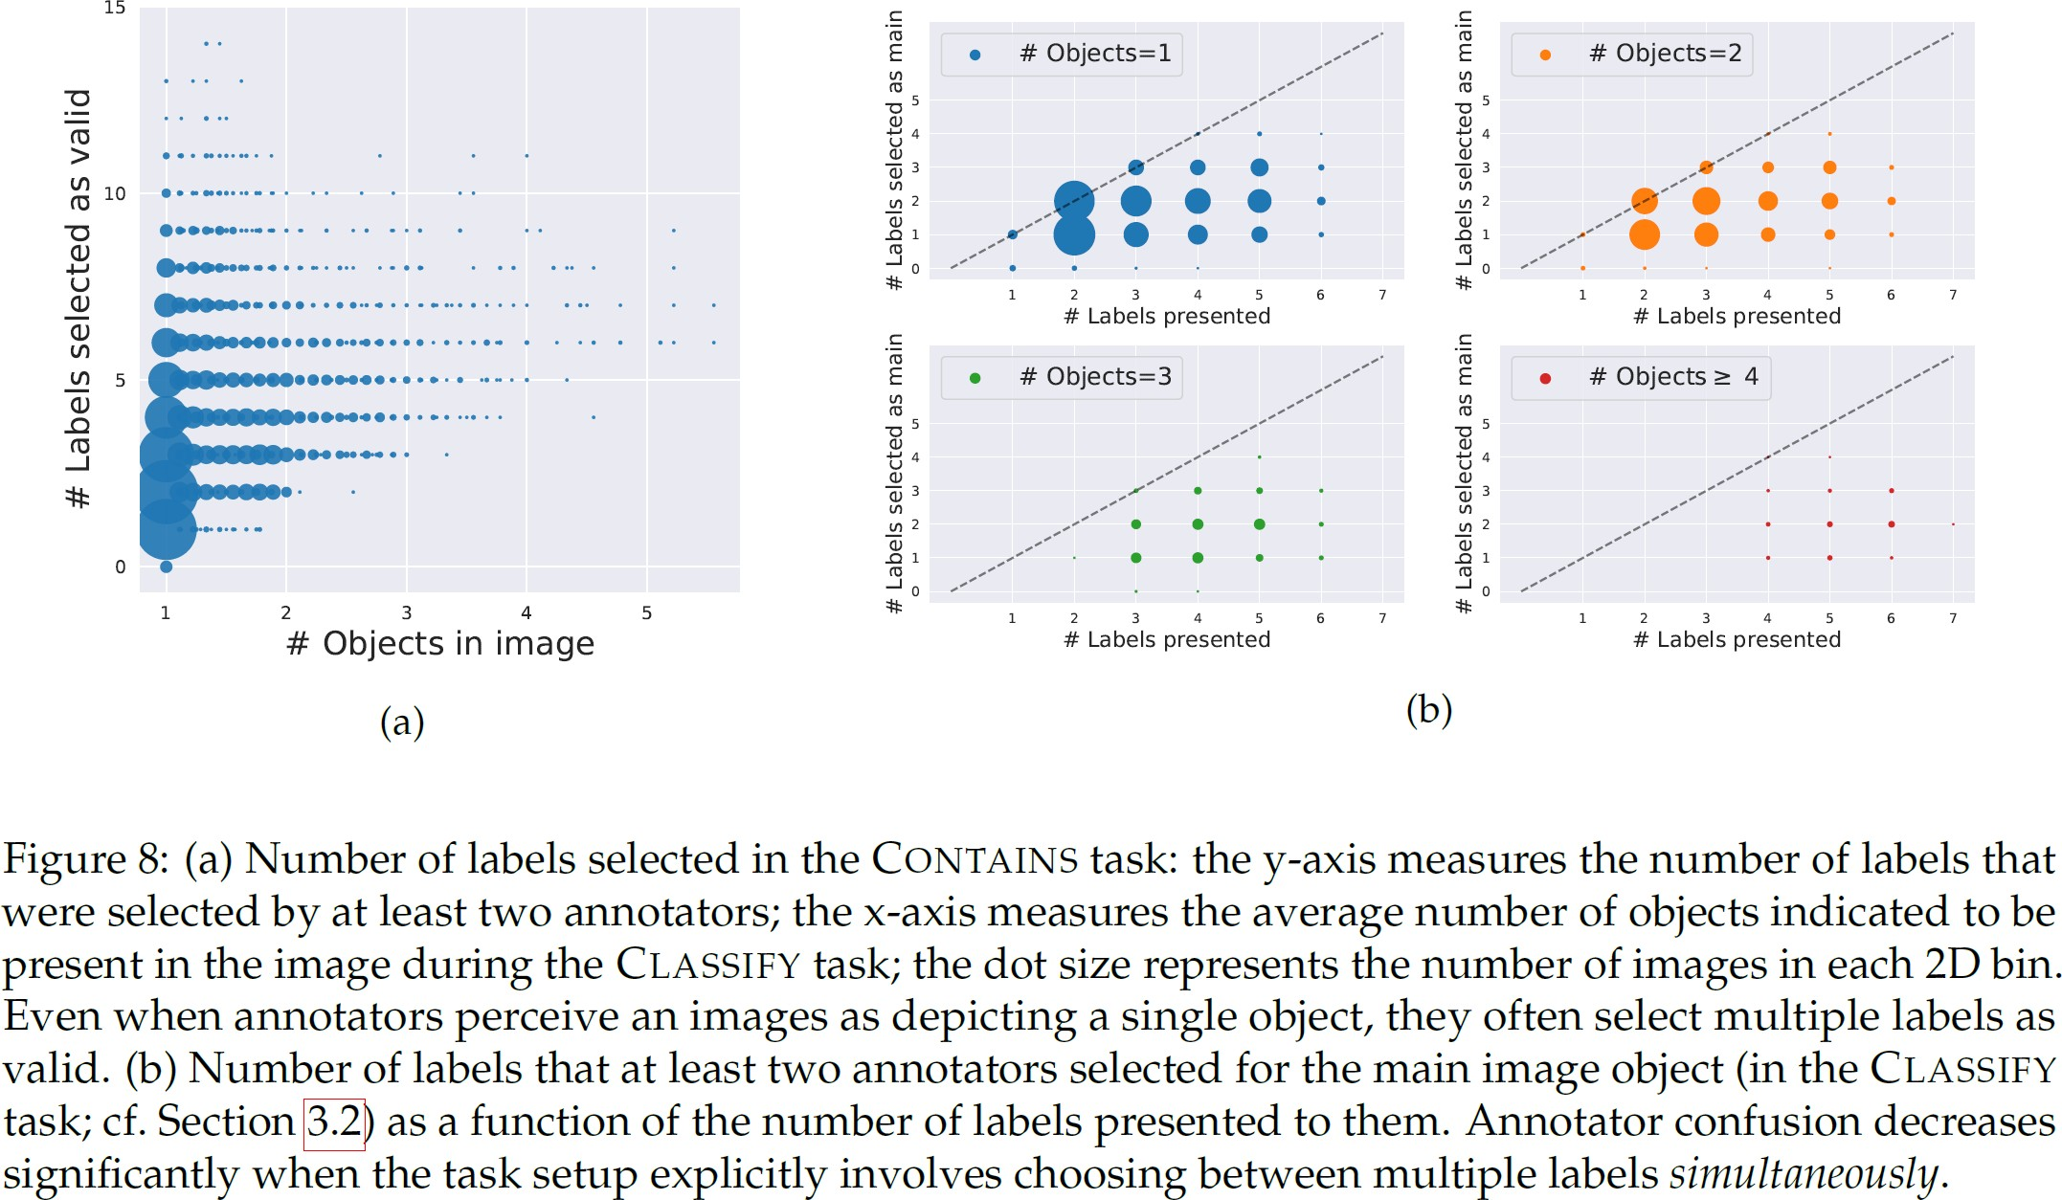
Bias in Label Validation

Slide 24
Bias in Label Validation
Confusing class pairs
There are several pairs of ImageNet classes that annotators have trouble telling apart—they consistently select both labels as valid for images of either class.
On some of these pairs we see that models still perform well.
However, for other pairs, even state-of-the-art models have poor accuracy (below 40%).
If that is indeed the case, it is natural to wonder whether accuracy on ambiguous classes can be improved without overfitting to the ImageNet test set.
The annotators’ inability to remedy overlaps in the case of ambiguous class pairs could be due to the presence of classes that are semantically quite similar, e.g., “rifle” and “assault rifle”.
In some cases, there also were errors in the task setup. For instance, there were occasional overlaps in the class names (e.g., “maillot” and “maillot, tank suit”) and Wikipedia links (e.g., “laptop computer” and “notebook computer”) presented to the annotators.

Slide 26
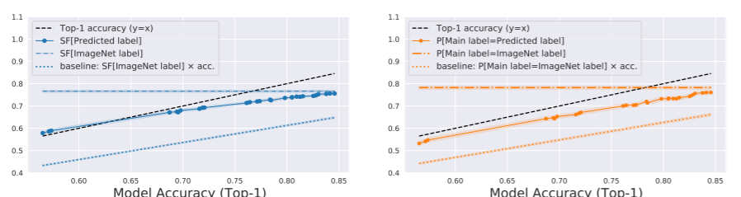
Beyond Test Accuracy
Human assessment of model predictions
Selection frequency of the prediction
How often annotators select the predicted label as being present in the image (determined using the CONTAINS task).
Accuracy based on main label annotation
How frequently the prediction matches the main label for the image, as obtained using our CLASSIFY task.

Slide 27
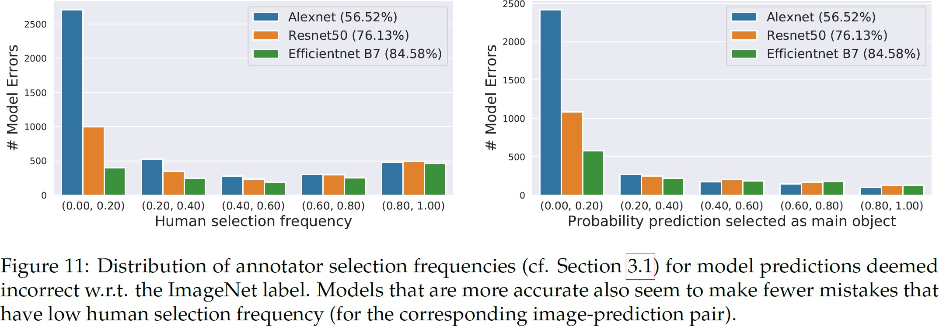
Human Assessment of Model Predictions – Incorrect Predictions

Slide 28
Human Assessment of Model Predictions
The predictions of state-of-the-art models have gotten, on average, quite close to ImageNet labels.
That is, annotators are almost equally likely to select the predicted label as being present in the image (or being the main object) as the ImageNet label.
This indicates that model predictions might be closer to what non- expert annotators can recognize as the ground truth.
This also means, we are at a point where we may no longer by able to easily identify (e.g., using crowd-sourcing) the extent to which further gains in accuracy correspond to such improvements.

Slide 29
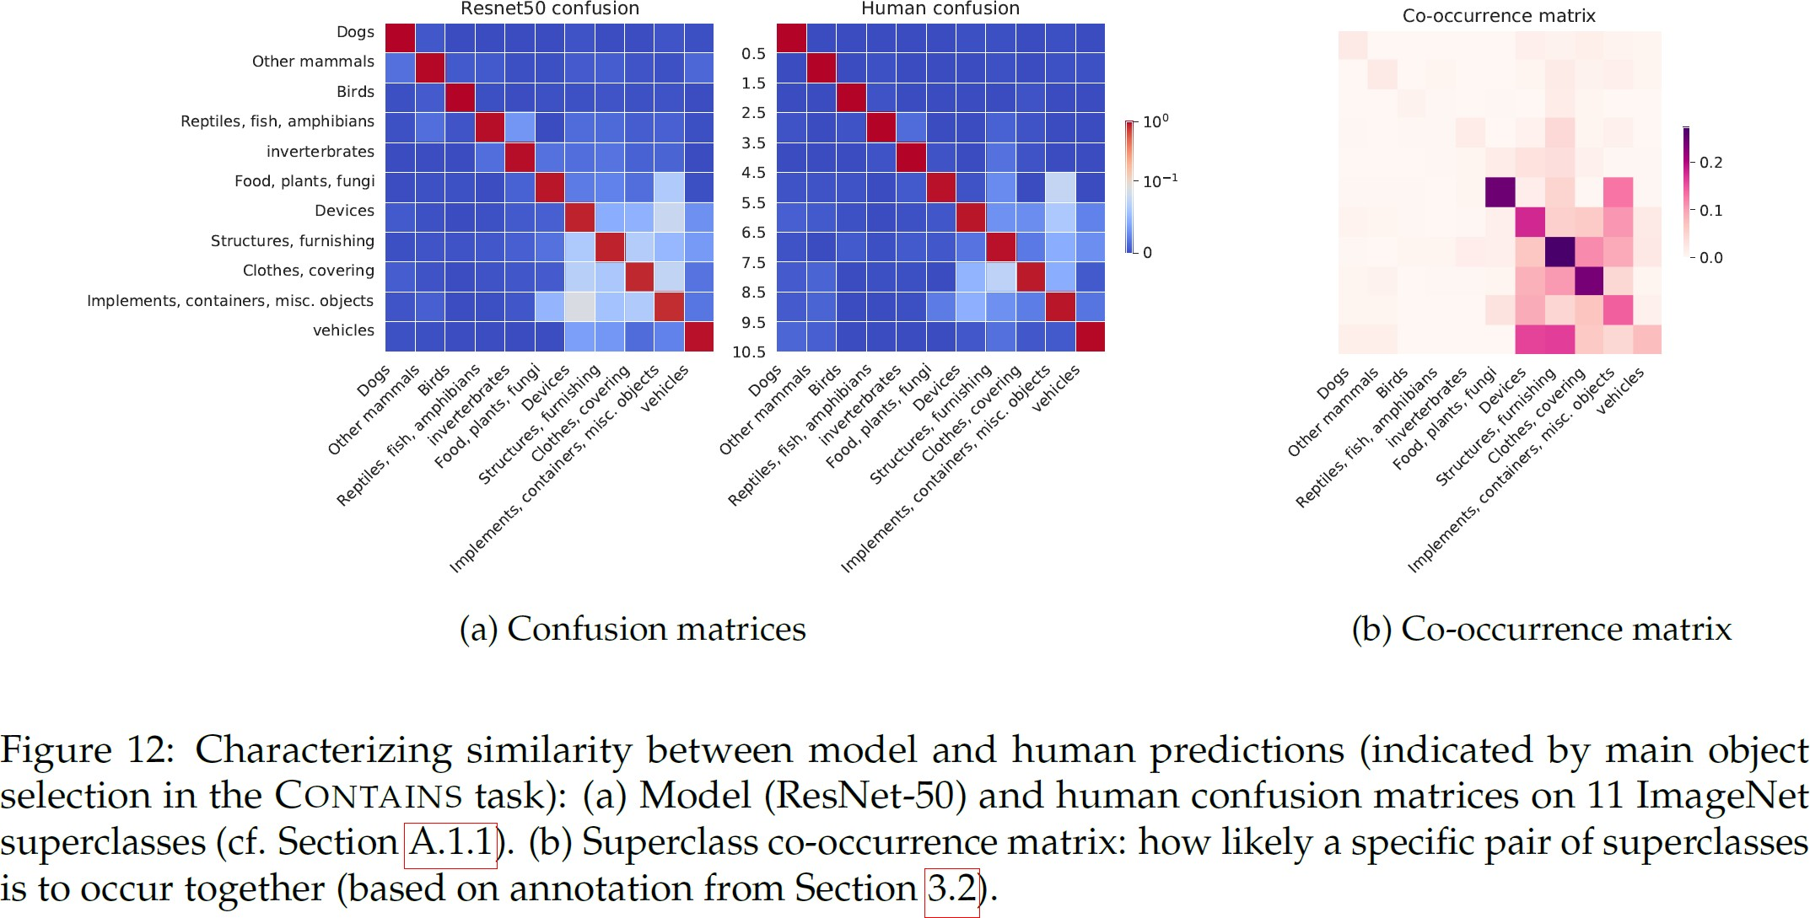
Confusion Matrix

Slide 30
Conclusion
There are many images with multiple valid labels, and ambiguous classes in ImageNet.
Top-1 accuracy often underestimates the performance of models by unduly penalizing them for predicting the label of a different, but also valid, image object.
Taking a step towards evaluation metrics that circumvent these issues, authors utilize human annotators to directly judge the correctness of model predictions.
On the positive side, they find that models that are more accurate on ImageNet also tend to be more human-aligned in their errors.
While this might be reassuring, it also indicates that we are at a point where we cannot easily gauge (e.g., via simple crowd-sourcing) whether further progress on the ImageNet benchmark is meaningful, or is simply a result of overfitting to this benchmarks’ idiosyncrasies.

